Slide 1
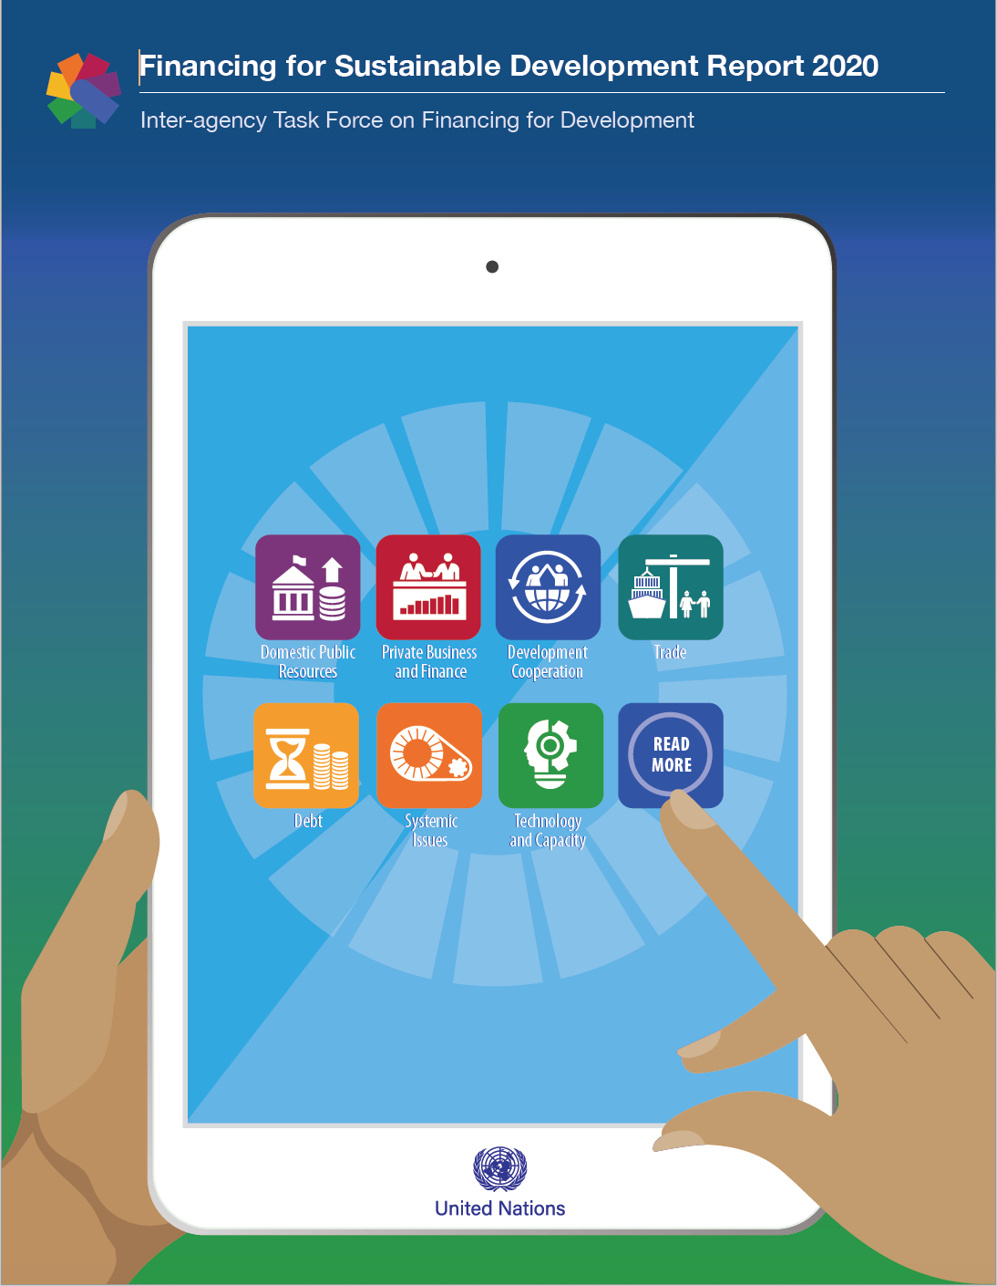

2020 Financing for Sustainable Development Report (FSDR)
by the Inter-agency Task Force on Financing for Development
More than 60 United Nations Agencies and international organizations.
Led by UN-DESA, with the IMF, WBG, UNDP, UNCTAD and WTO in leading roles
http://developmentfinance.un.org

Slide 2
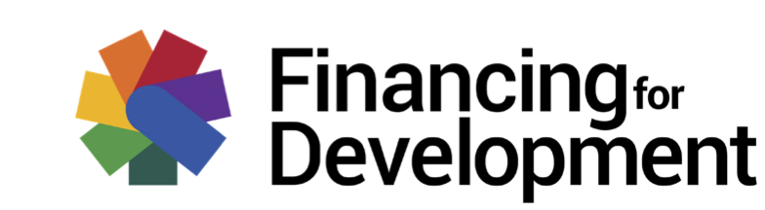
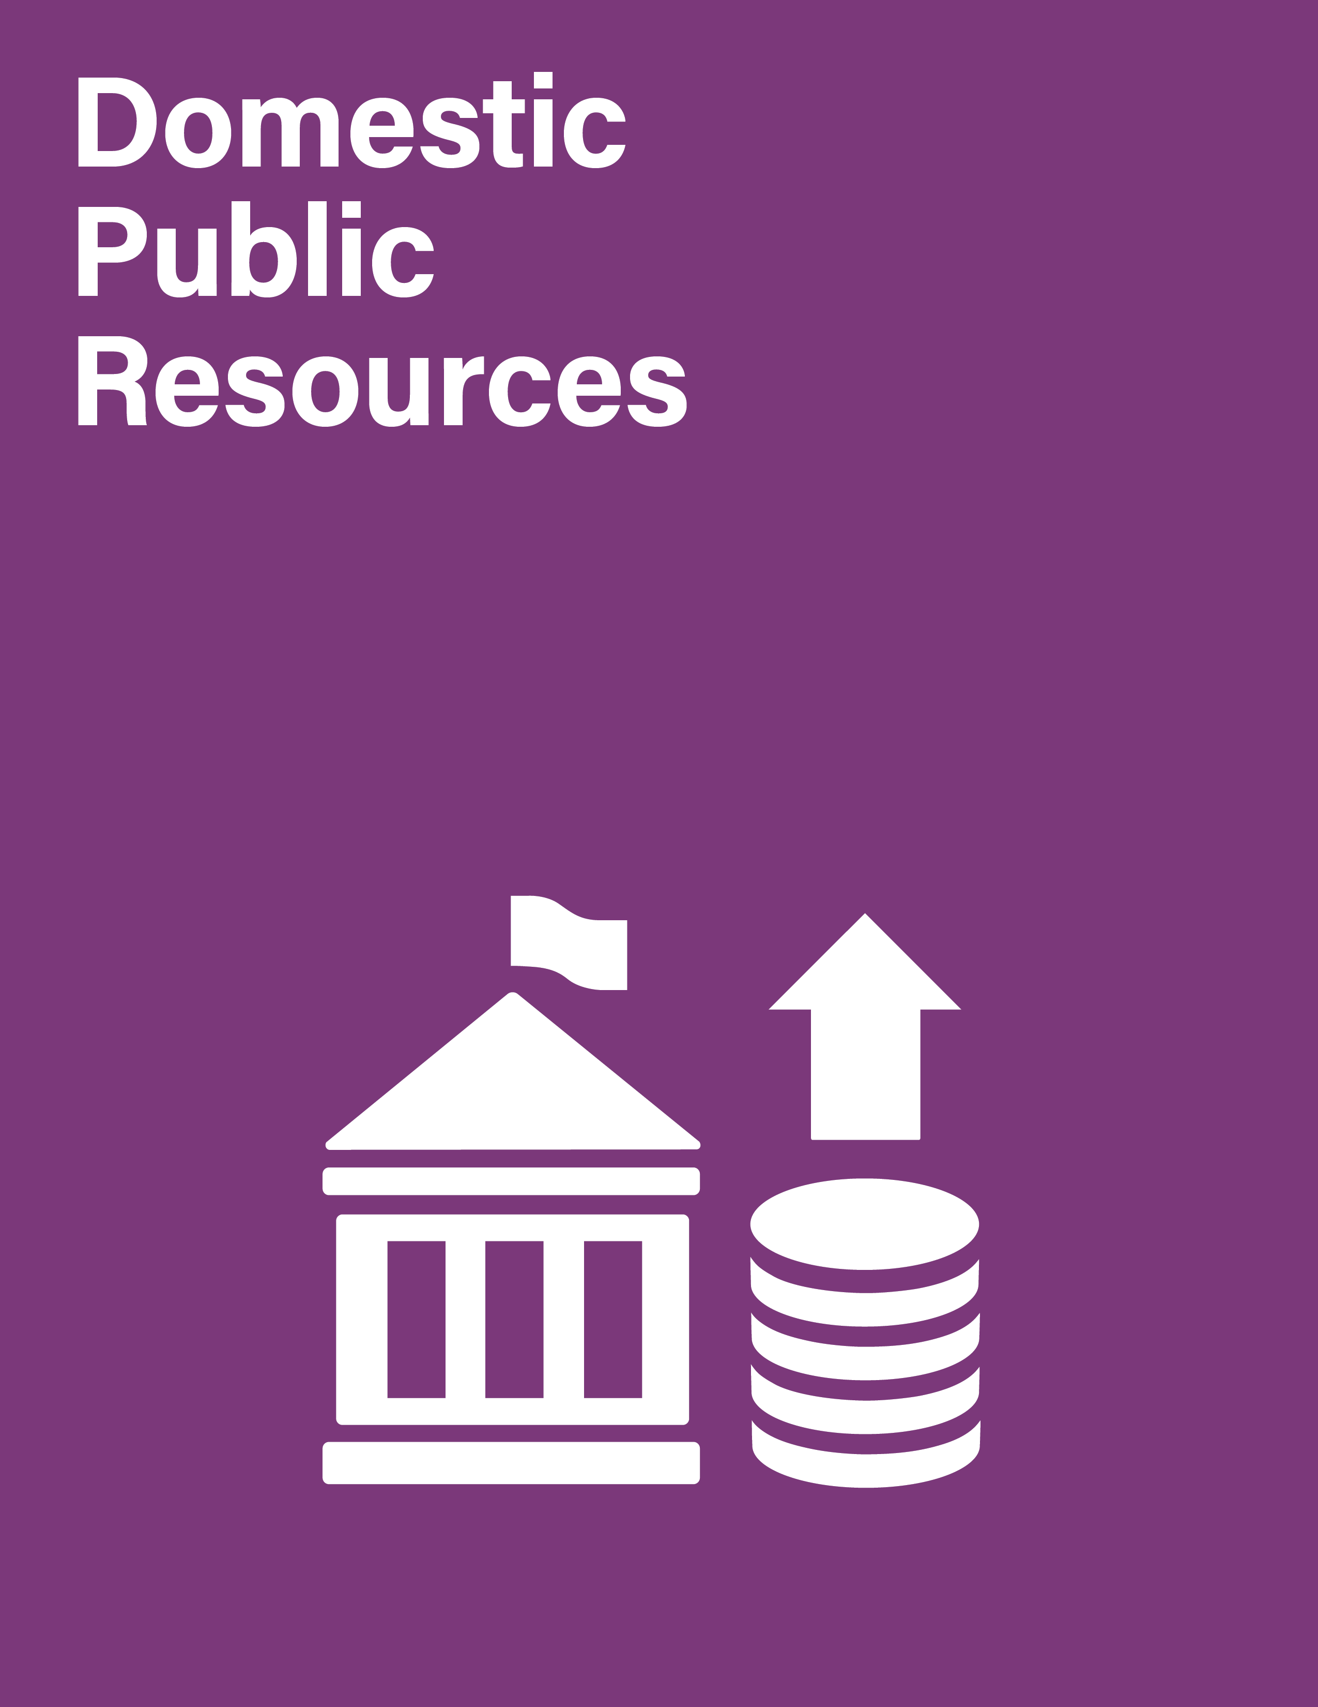
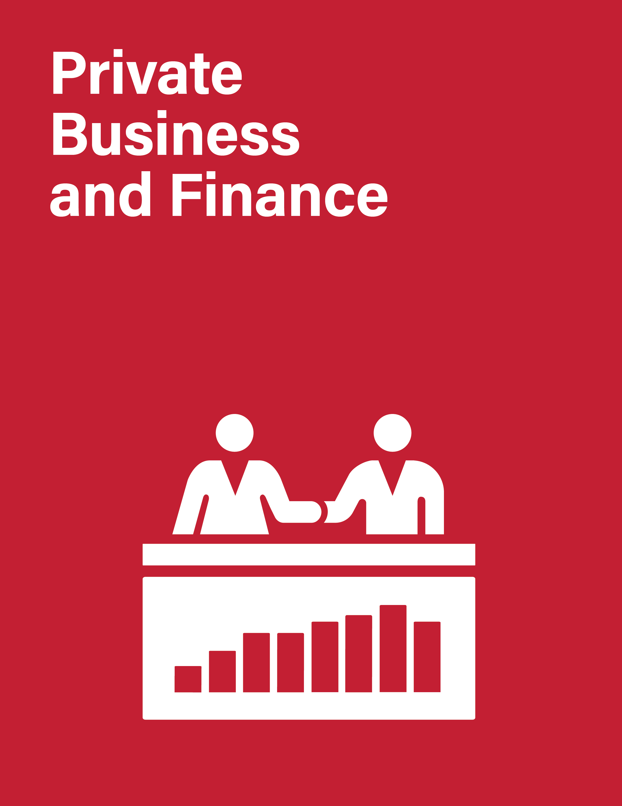

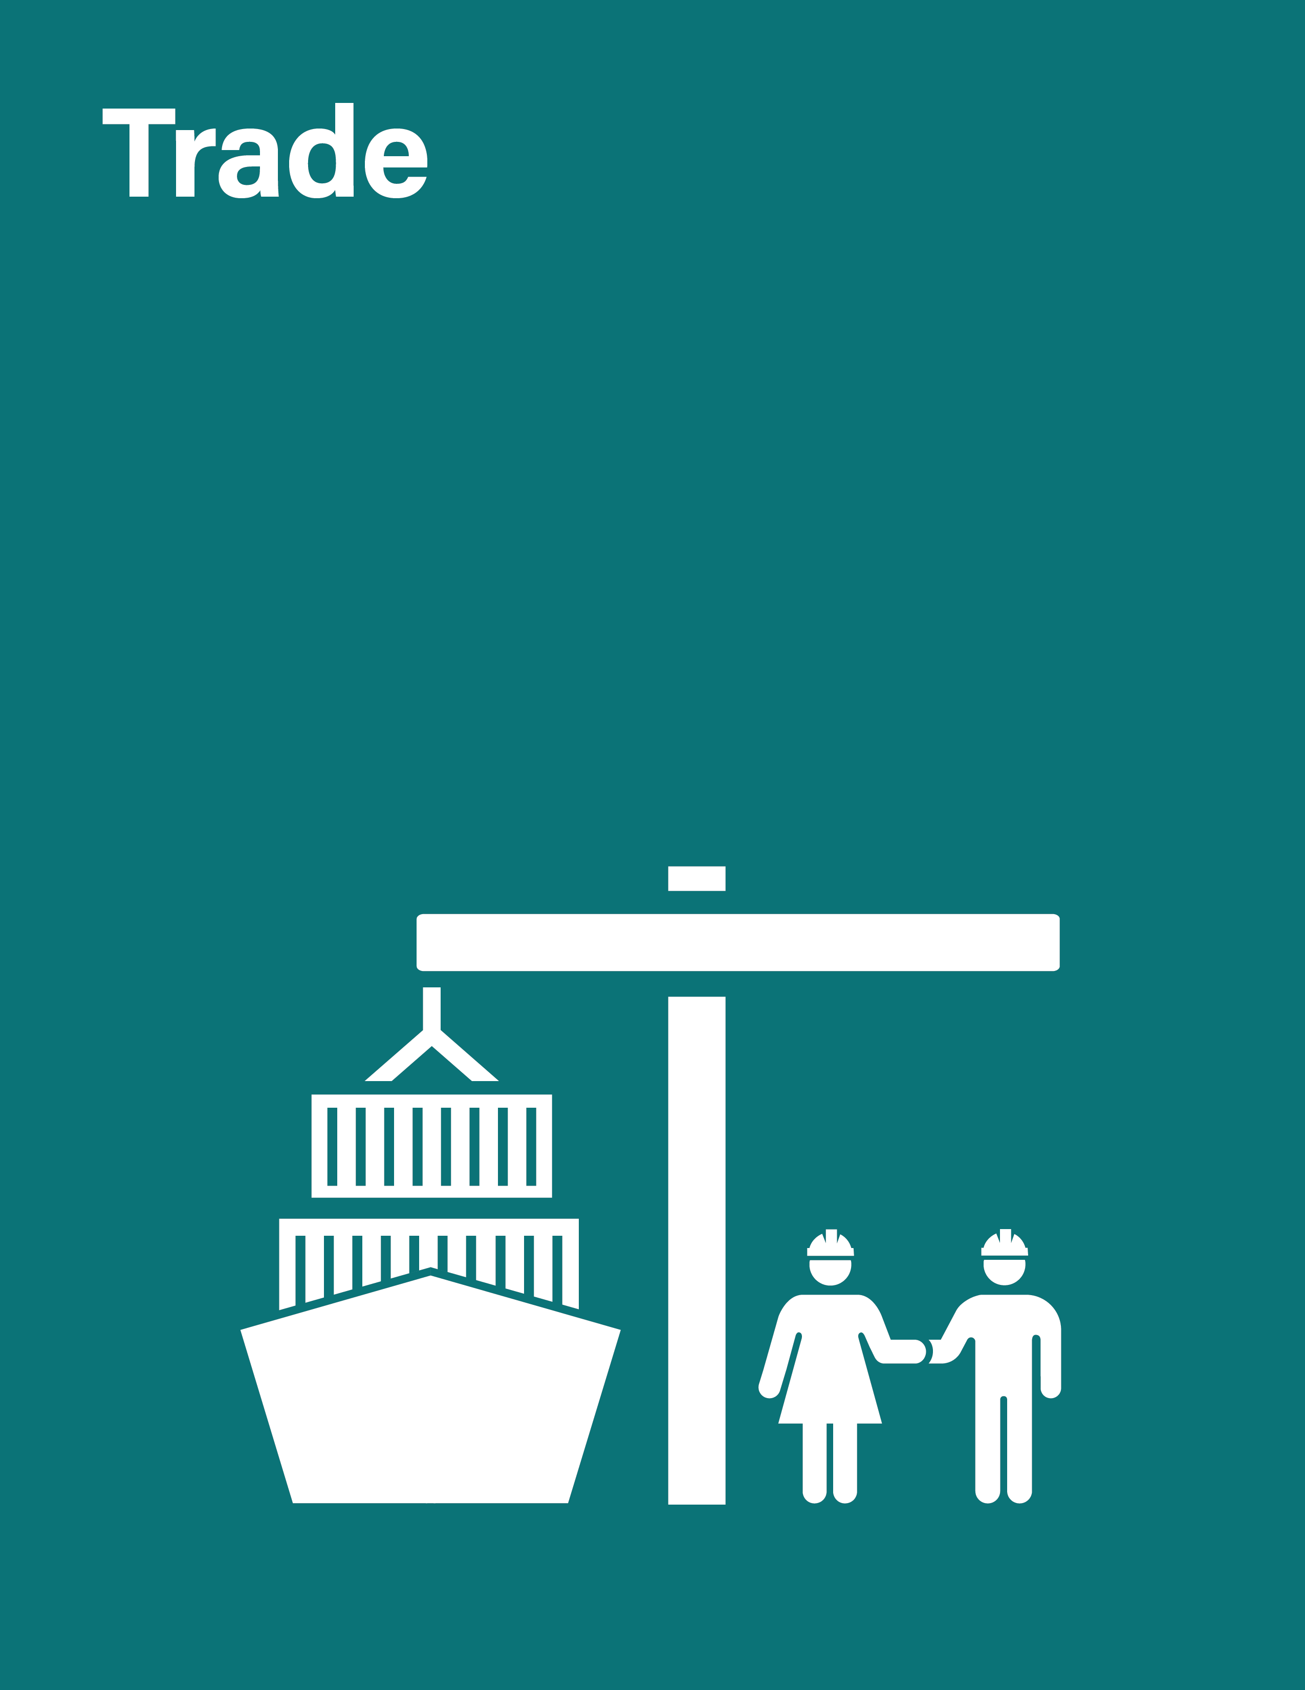
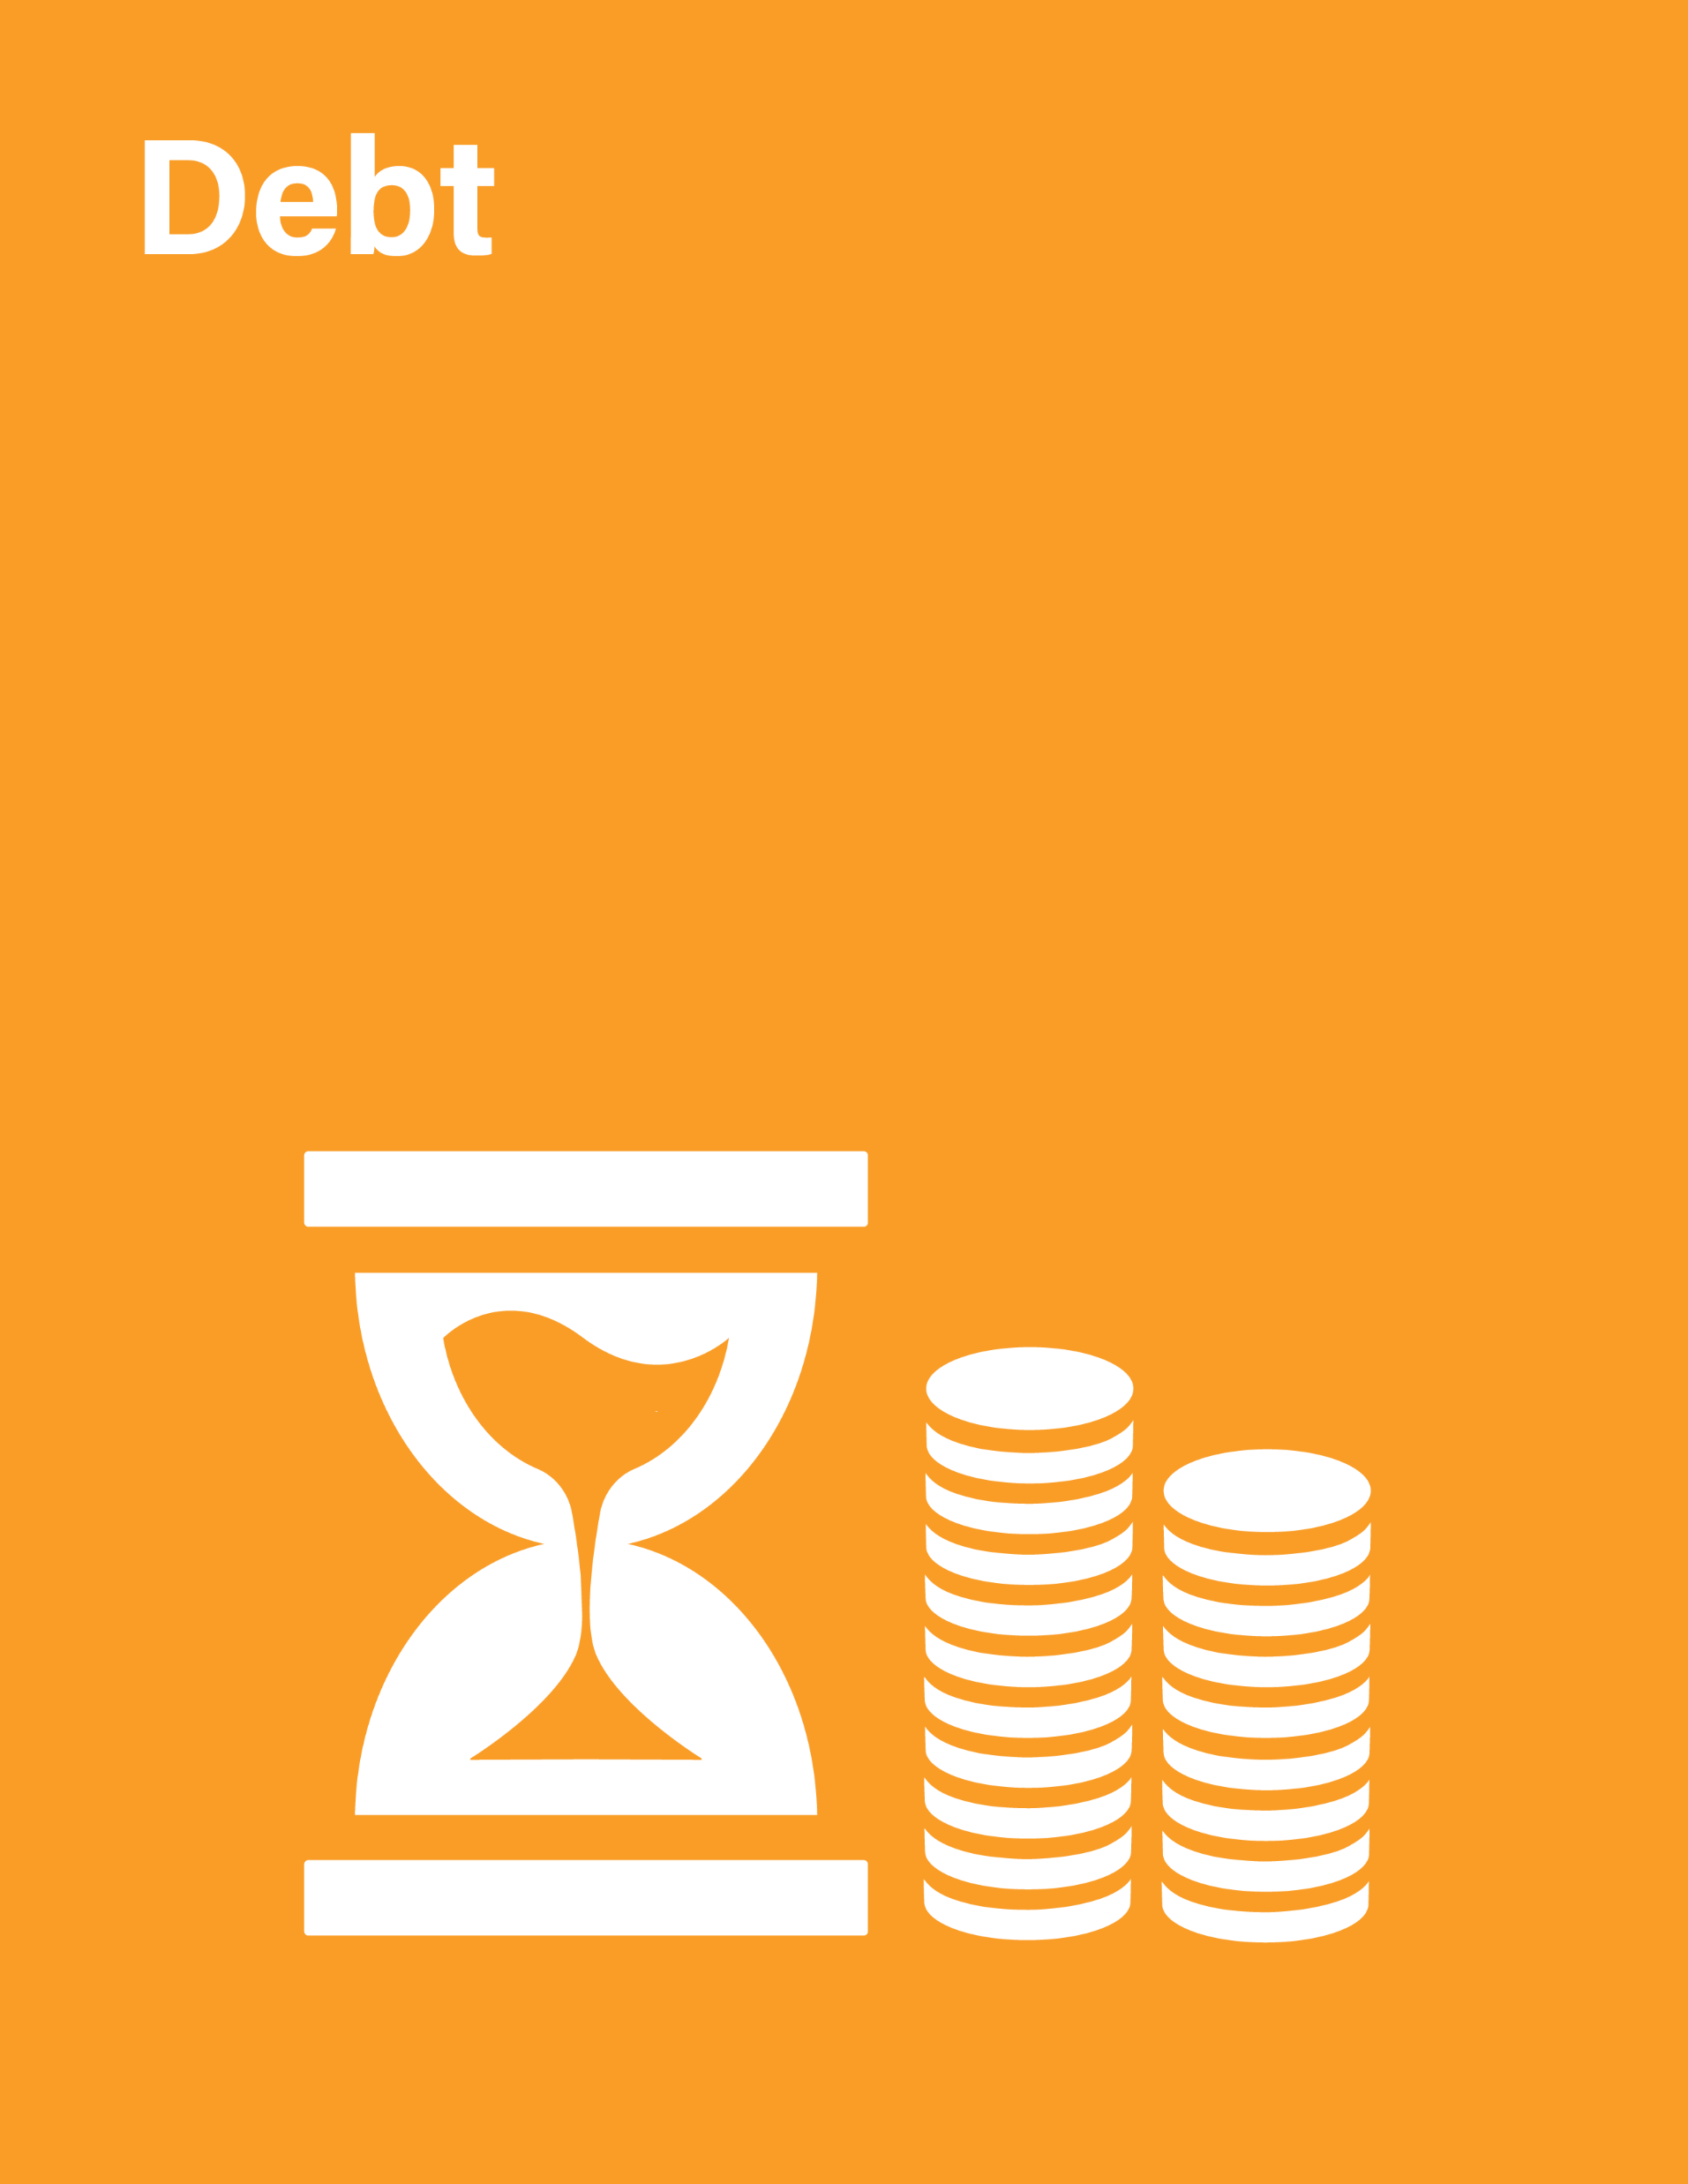


2020 FSDR - Outline
Global
Economic
Context
Thematic Chapter:
Transformative Digital Technologies
Data
Inter-agency Task Force on Financing for Development
http://developmentfinance.un.org

Slide 3
Main Messages from the 2020 FSDR:
The global context
The global economic recession and financial turmoil from COVID-19 are derailing the Addis Agenda and the SDGs:
  Investors removed almost USD $100 billion out of emerging markets during Feb-March -- the largest outflow ever recorded;
  Collapsing trade and investment;
  Sharp contraction in remittances.
But even before the pandemic:
  ODA fell 4.3%; ODA to LDCs fell 2.2% in 2018;
  1/5 countries were likely to see per capita incomes stagnate or decline in 2020;
  Rising vulnerabilities in non-bank financial institutions.
Inter-agency Task Force on Financing for Development
http://developmentfinance.un.org

Slide 4
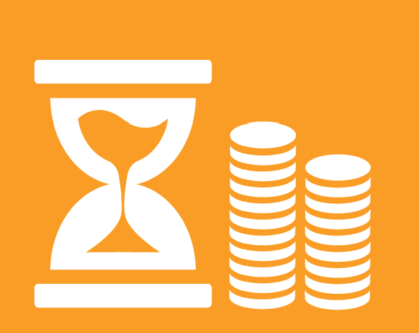
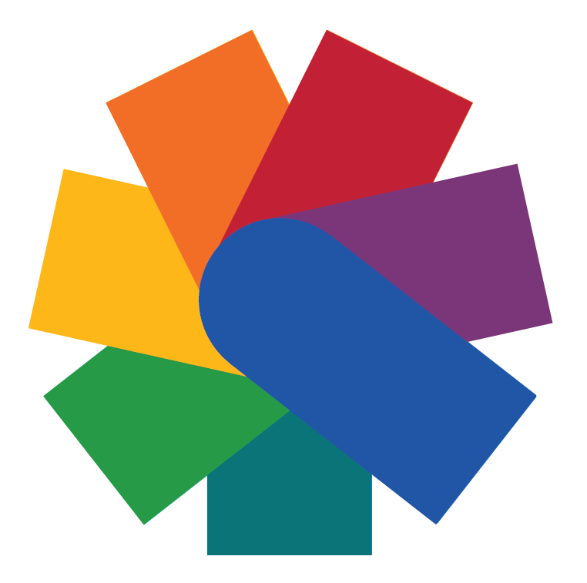
Particularly worrisome is the prospect of a new debt crisis
COVID-19 has enormous fiscal impacts... and
Exacerbates risks of a debt crisis!
44% of LDCs and other LICs were already at high risk of or in debt distress
25% of public revenue was used for debt payments in frontier economies
Global debt will rise further…
More LICs, but also many MICs – particularly those that depend on tourism or commodity exports – are at high risk of shocks and debt distress
Public debt will rise further in response to COVID-19
Highly-leveraged corporations are vulnerable to shocks – COVID-19 could turn into a protracted crisis
Inter-Agency Task Force on Financing for Development
Financing for Sustainable
Development Report 2020
http://developmentfinance.un.org

Slide 5
Main Messages from the 2020 FSDR:
Immediate actions and medium-term policy solutions required
A globally coordinated stimulus package, including reversing the decline in aid and increased concessional finance; supporting global liquidity through SDRs.
Prevent a debt crisis:
  Immediately suspending debt payments from poor countries;
  Beyond the crisis, reassess debt sustainability/revisit existing mechanisms.
Stabilize financial markets by continuing to inject liquidity:
  Use of capital account management;
  In the medium-term, explore regulatory frameworks to limit over-borrowing for non-productive investments, such as repaying shareholders.
Partnering with the private sector:
  In the short term, roll over debt to SMEs and individuals;
  In the medium-term, promote sustainable investment.
Inter-agency Task Force on Financing for Development
http://developmentfinance.un.org

Slide 6
Main Messages from the 2020 FSDR:
Additional policy solutions
Building back better for sustainable development:
  Public and private investment in sustainable development including in resilient infrastructure;
  Strengthened social protection systems;
  Investment in crisis prevention, risk reduction and planning;
  Eliminate trade barriers and restrictions that affect supply chains.
  Policy responses need to be human-centred and gender-responsive, designed to help those most in need.
Digital technologies present tremendous potential for the SDGs, as highlighted by the use of technology to respond to the COVID-19 pandemic. But the pandemic has also highlighted inequities in access. And digital technologies raise new risks and challenges.
  Public policies should be adjusted to accelerate progress, address exclusion and risks of discrimination, and ensure benefits for the society at large, including decent jobs.
Inter-agency Task Force on Financing for Development
http://developmentfinance.un.org

Slide 7

Thank you!

